Slide 1
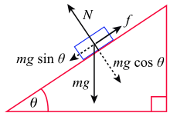
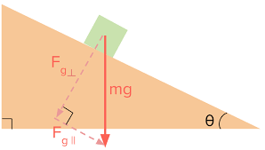
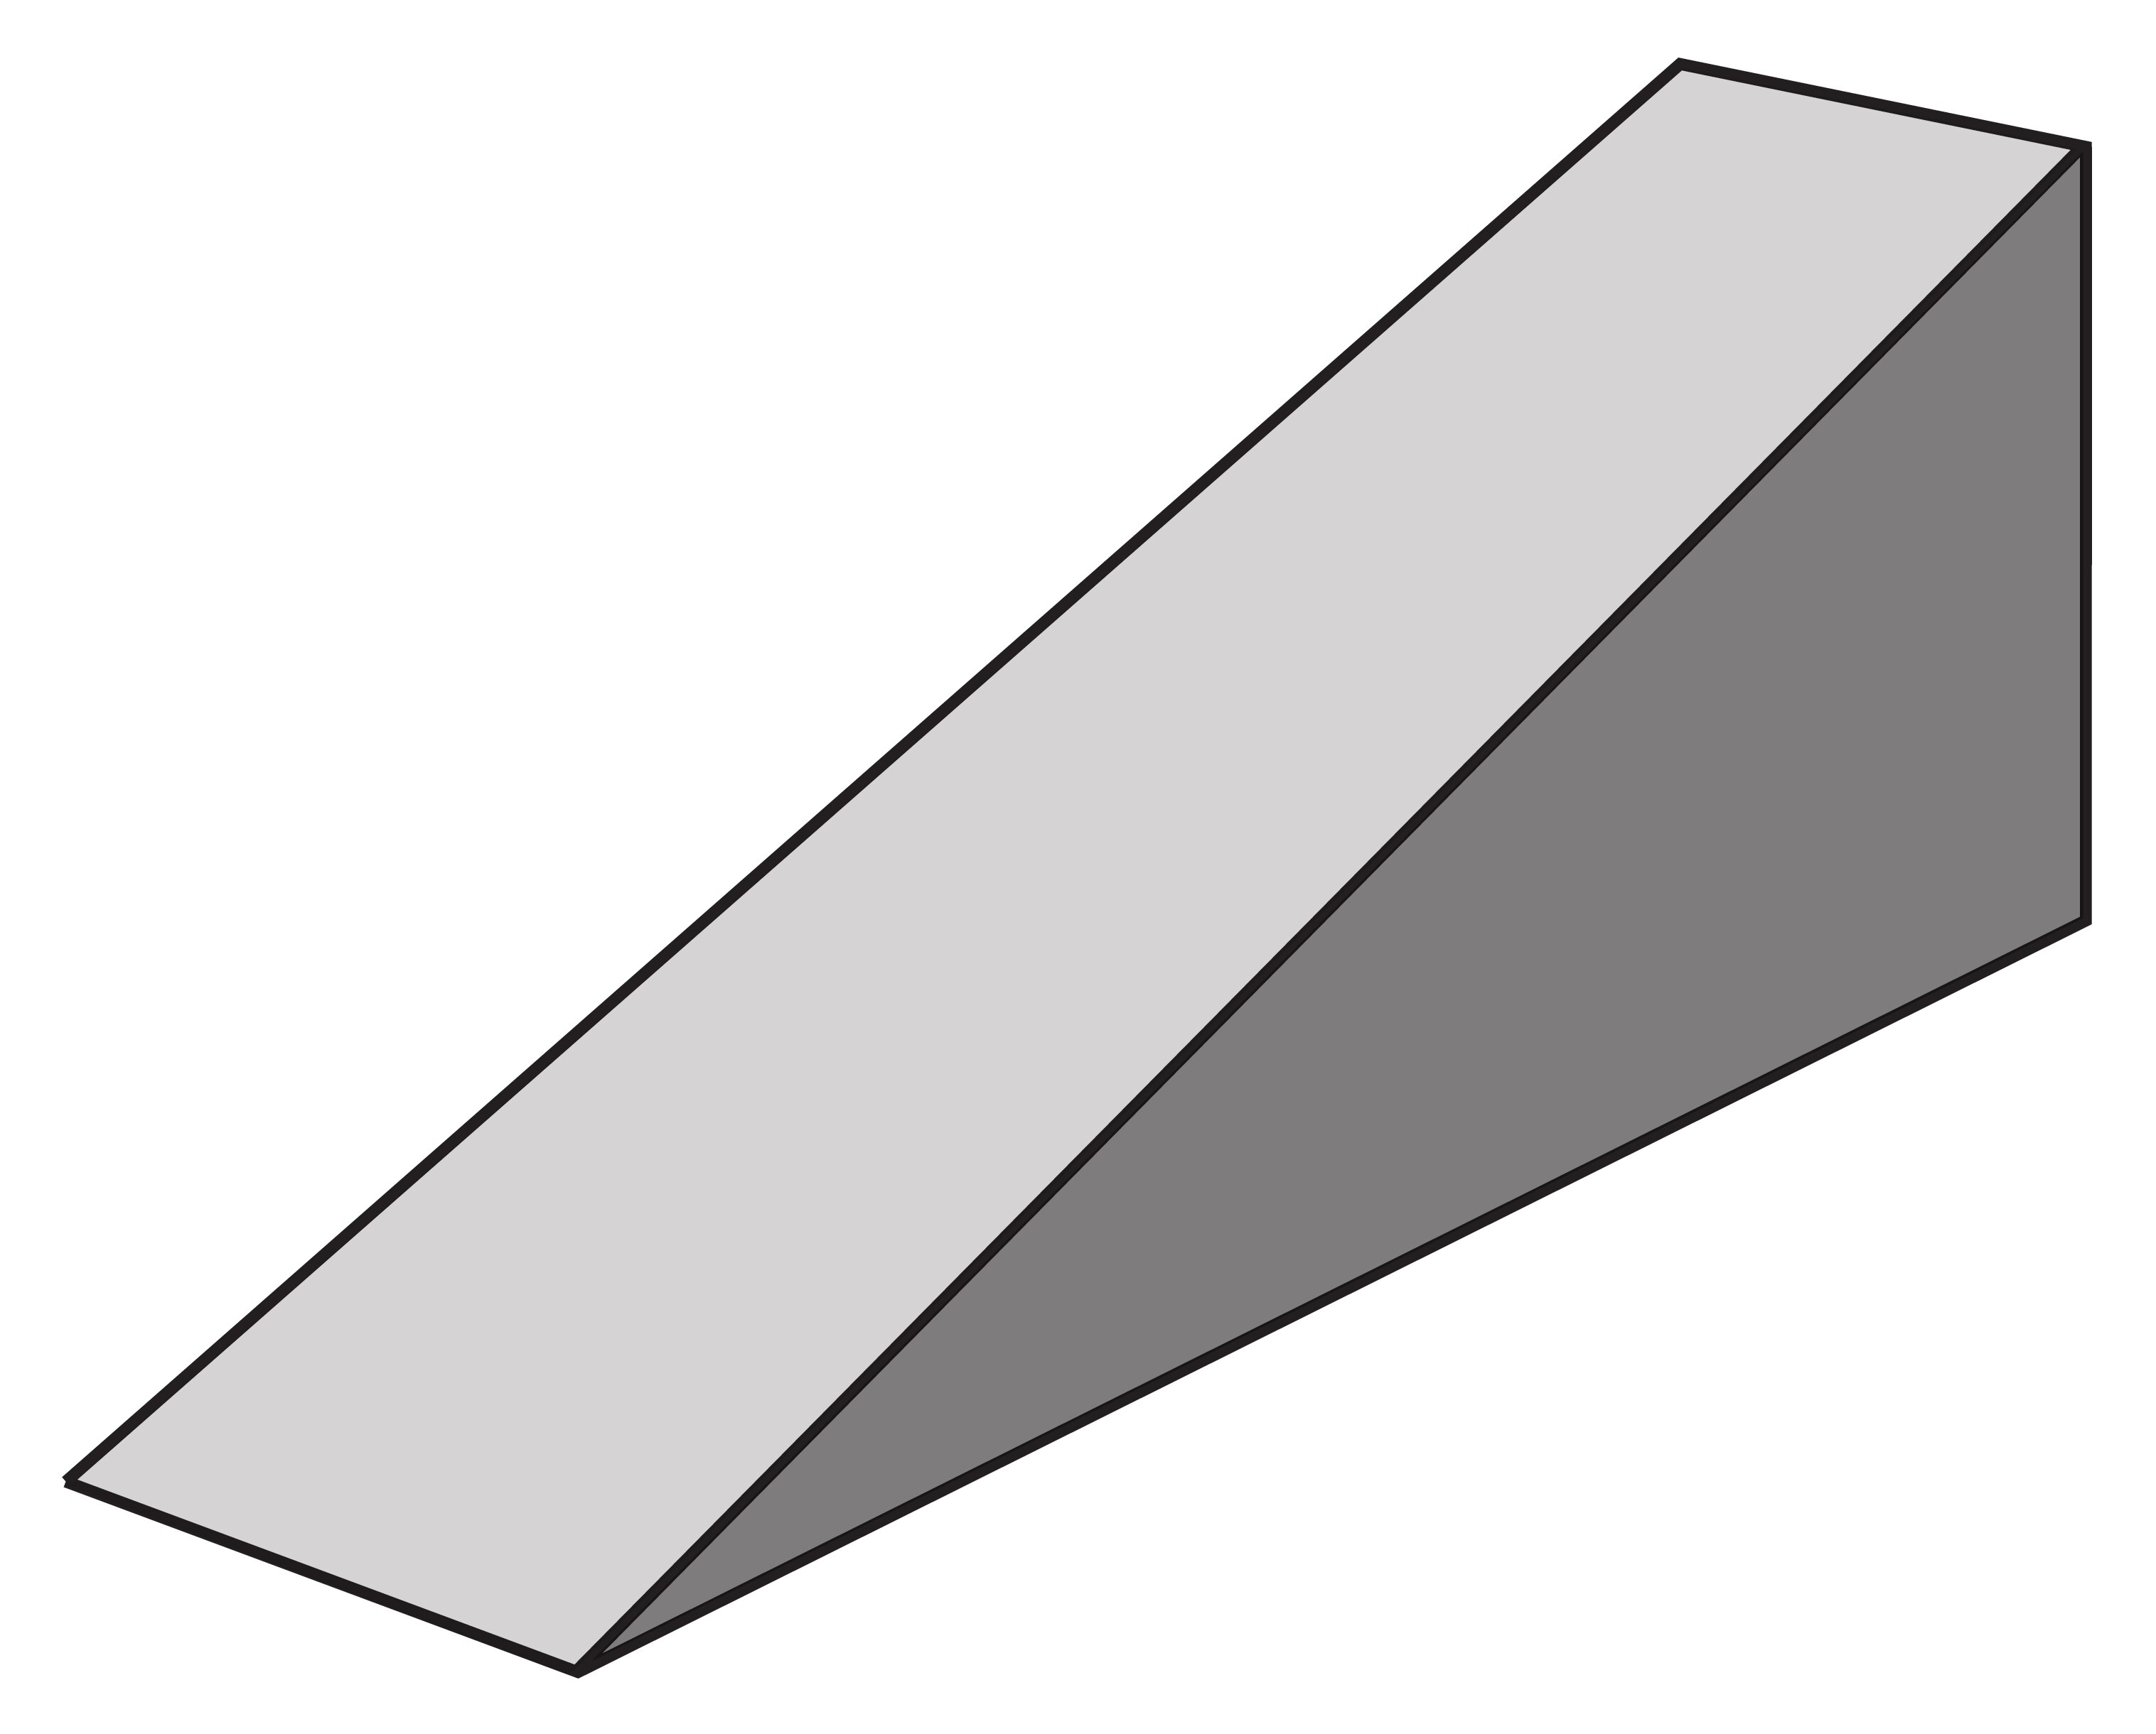

Inclined Planes
It’s all downhill from here…

Slide 2
Forces on an Inclined Plane
F_{R}
F_{N}
W
F_{N}
F_{R}
θ
Note that the force down the slope (F_{R}) is not a new force; it is simply the resultant of the weight force (W) and the reaction (normal) force (F_{N}). Normal force is perpendicular to slope.
W

Slide 3
Angles for forces on an Inclined Plane
F_{R}
F_{N}
W
F_{N}
F_{R}
θ
Note that the force down the slope (F_{R}) is parallel to the slope, whereas the normal force (F_{N}) is perpendicular to the slope. Therefore, these forces are perpendicular (right angles) to one another.
W
Notes:
If it is true for the diagram on the left then it must also be true for the diagram on the right (for finding angles/magnitudes).

Slide 4
Angles for forces on an Inclined Plane
Extend this line only so we can work out where θ goes
F_{R}
F_{N}
Straight Line = 180˚
W
θ
θ
F_{N}
90-θ
F_{R}
θ
W
Notes:
Note that, to get to this final vector diagram, we have been obliged to draw at least 3 diagrams.

Slide 5
Solving for forces on an Inclined Plane
So, we started with this diagram…
F_{R}
F_{N}
W
θ
F_{N}
F_{R}
…and ended with this diagram.
θ
Suppose now we were to pose a question; for an object of mass ‘m’, sliding down an incline plane angled at θ˚ to the horizontal, could we find an expression for the acceleration experienced by the object?
W

Slide 6
Solving for forces on an Inclined Plane
F_{R} = mg sin θ
*SOH CAH TOA
F_{R}
F_{N}
α
F_{R} = mg cos α
W
W = mg
F_{N}
θ
F_{N} = mg cos θ
α
F_{N} = mg sin α
F_{R}
*Note: had we been given ‘α’ and not ‘θ’, things would have looked slightly different – be sure to read questions and construct diagrams carefully.
∴ a = g cos α
θ
F_{R} = mg sin θ
Recall F = ma
∴ mg sin θ = ma
∴ a = g sin θ
W = mg
W
Notes:
Note that this result passes the common sense test (test θ = 0˚ , θ = 90˚ )

Slide 7
Solving for forces on an Inclined Plane
We could have found the same result a quicker way…
90-θ
θ
θ
g┴
θ
90-θ
g┴
g_{װ} = a = g sin θ (using SOH CAH TOA)
g
g
θ
g_{װ}
g_{װ}
*Vertically Opposite Angles (X-Rule)

Slide 8
Friction?
Until now we have considered only frictionless cases. What about something more realistic?
Friction can slow an objects’ descent down a slope, or it can completely stop it from moving. As friction operates to oppose motion, the vector calculation is fairly straightforward (find the sum of forces first, then calculate acceleration).
Consider an example; a 5.00 kg mass slides down an incline of 45˚. A friction force of 14.65 N acts to oppose the motion of the mass.
Find the acceleration of the mass down the slope.
Find the size of the friction force required to prevent the mass from sliding down the slope.
F_{N}
F_{Friction}
F_{R}
θ
W
Notes:
a. 4.00 m/s/s, b. 34.65 N. Note that the same logic would apply for ‘find the tension in the rope holding the mass in place’, or some such similar question. Note that in this case the force triangle gets back to where it started, meaning forces are in equilibrium.

Slide 9
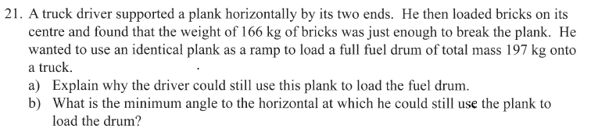

Slide 10
F_{R}
Apparent weight on plank = magnitude of normal force. As the angle of the plank increases, the magnitude of the normal force decreases, meaning plank is less likely to experience sufficient force to break.
Force required to break plank:
F = 166 x 9.8 = 1626.8 N
Draw diagram of inclined plank:
W = 1930.6 N
F_{N}
θ
Find expression for F_{N}:
F_{N} = 1930.6 cos θ
What value of θ gives a normal force of 1626.8 N?
1626.8 = 1930.6 cos θ
θ = 32.6˚
F_{N}
F_{R}
θ
W = mg = 197 x 9.8 = 1930.6 N
Notes:
If the notion of normal force being used to determine the force exerted on the plank seems strange (since it is defined as almost exactly opposite), consider the notion of weight vs. apparent weight in a falling elevator – what reading would you get on a pair of scales?

